Slide 1
ONLINE FOOD DELIVERY APP

Slide 2
Team Members-Sseries
SONALY S -61781921110052
SANJAY S– 61781921110046
SELVAKUMAR M -61781921110048
SWETHA G - 61781921110056

Slide 3
PROBLEM STATEMENT
The problem statement for our project is to develop a online food delivery app that offers a diverse selection of restaurants, streamlines ordering, and supports local business..

Slide 4
INTRODUCTION
Our project aims to create a user-centric platform that connects hungry customers with a diverse selection of local restaurants and eateries.
From neighborhood favorites to trendy hotspots, our app will offer an extensive array of culinary options to satisfy every cravings and dietary preference.

Slide 5
OBJECTIVE
The objective of our online food delivery app is to provide a seamless and convenient platform connecting customers with local restaurants, while supporting sustainability and enhancing customer satisfaction.

Slide 6
Tools & Techniques
HTML – Version HTML5
CSS 4.15
JavaScript – ES6
Xampp – 8.2.12
SQL 16.0
Php – 8.3.6

Slide 7
IMPLEMENTATION
In our project, we have successfully developed a login page and content page that showcases comprehensive information about various food items, including the details about the respective restaurants and categories they belongs to…
This pages has been created using HTML,CSS and JavaScript ensuring a visually appealing and user-friendly presentation. in the backend, The login registration form serves as the gateway for users to access personalized features and content. 'Add to Cart' feature interfaces with the database to store item details and manage user sessions.

Slide 8
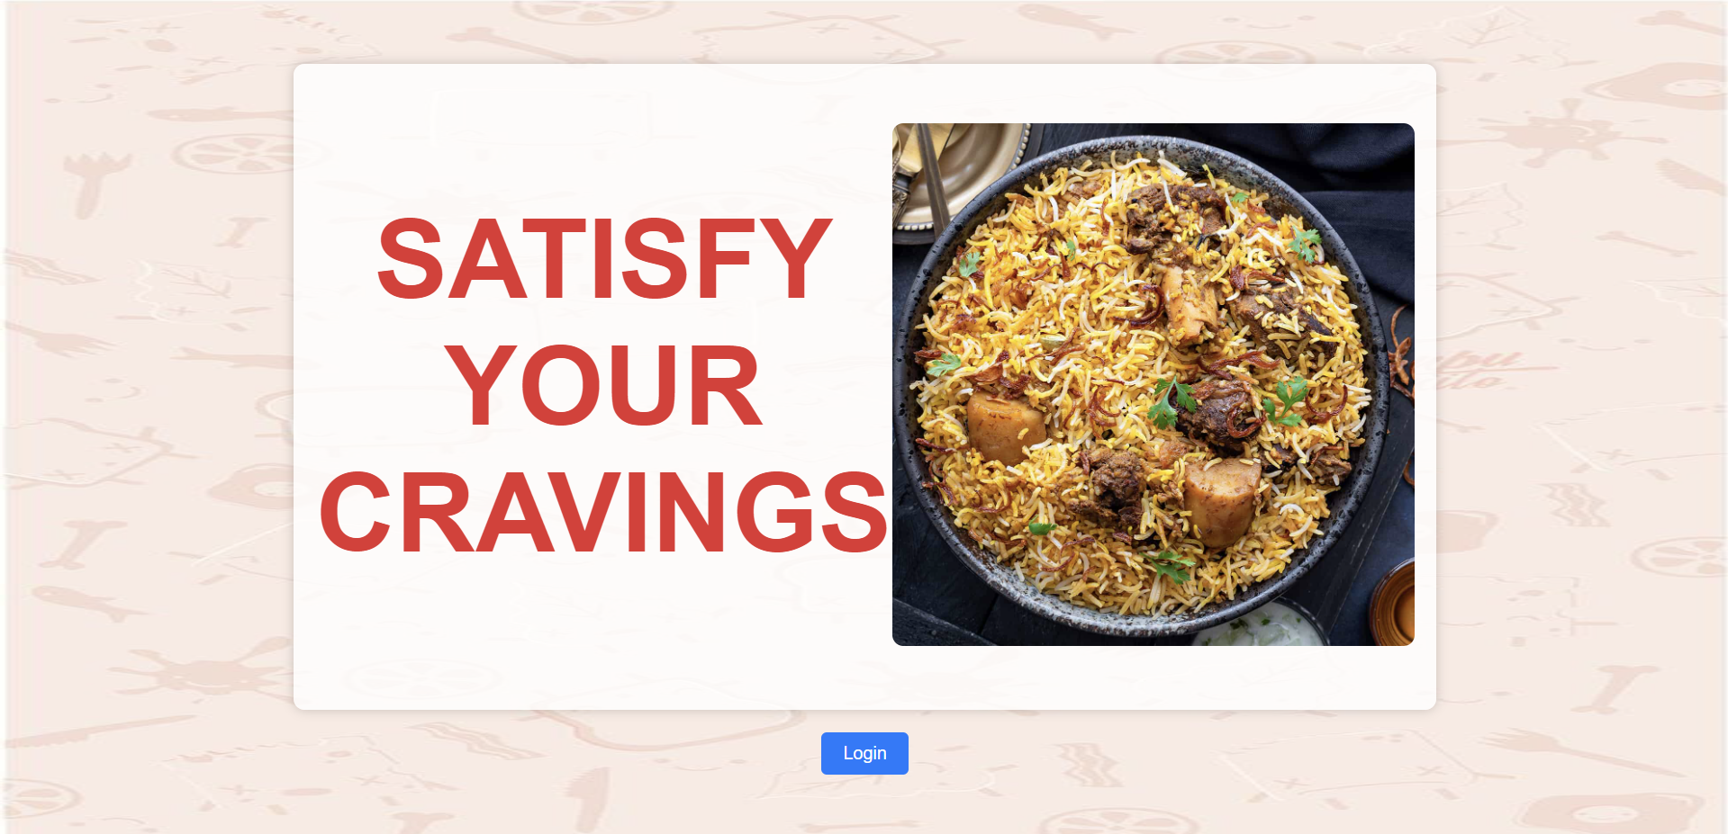
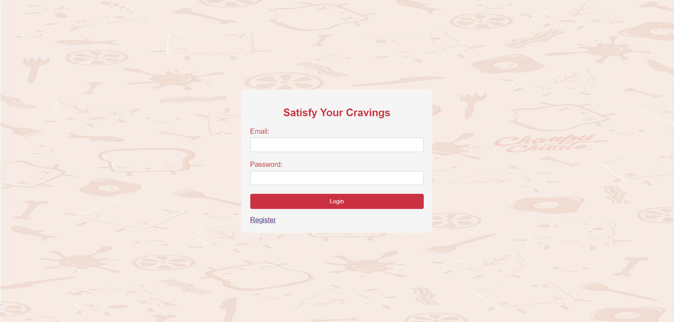
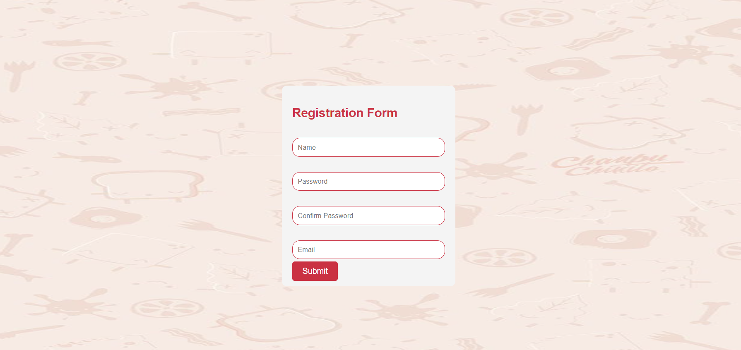
Product Demo(Frontend)

Slide 9
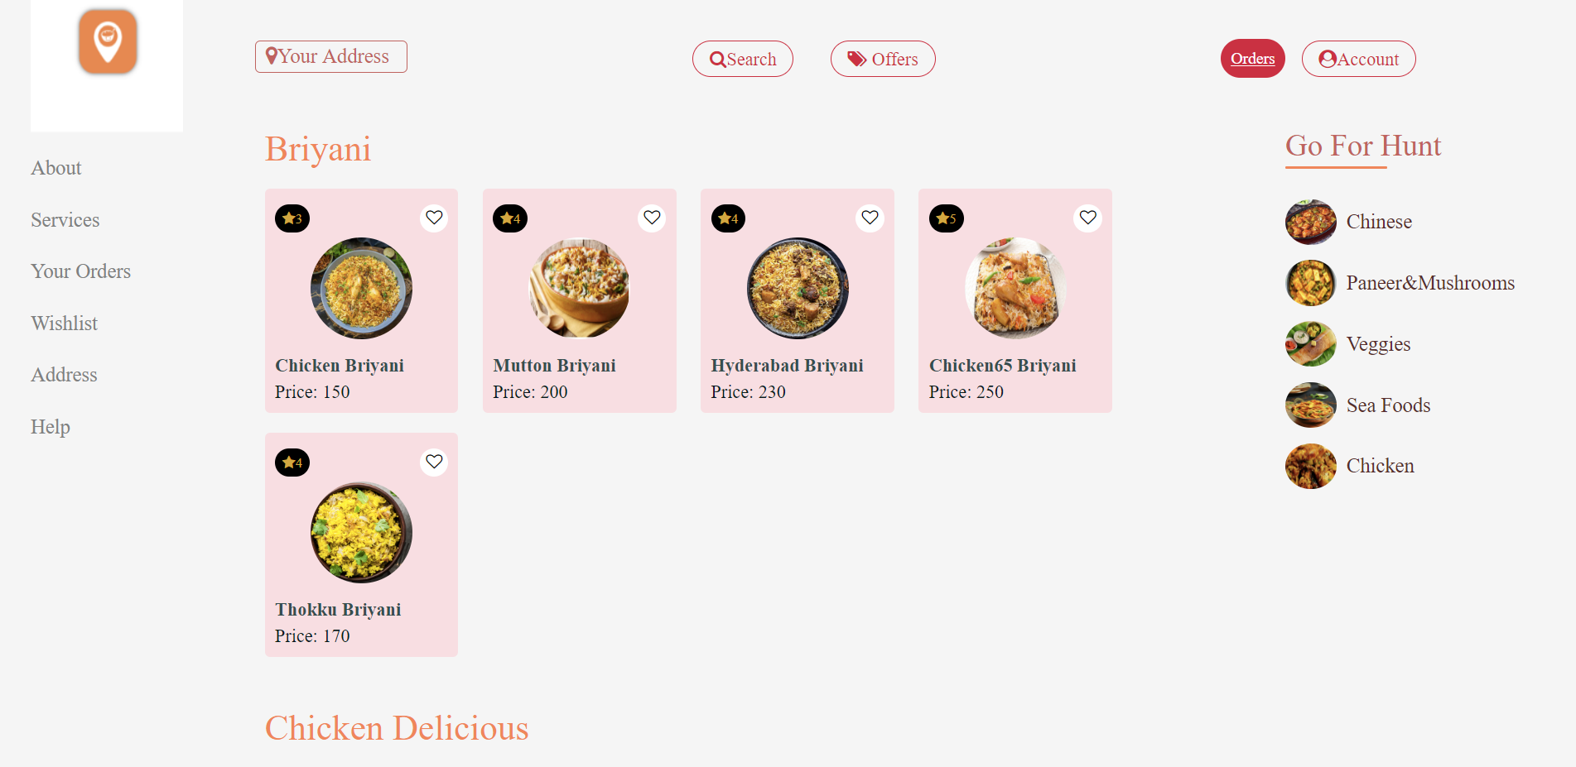
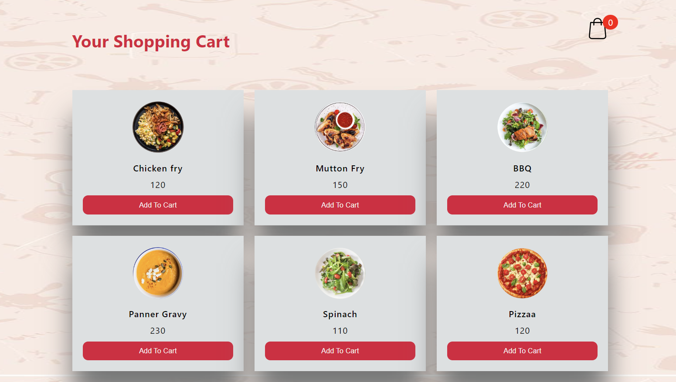
Product Demo

Slide 10
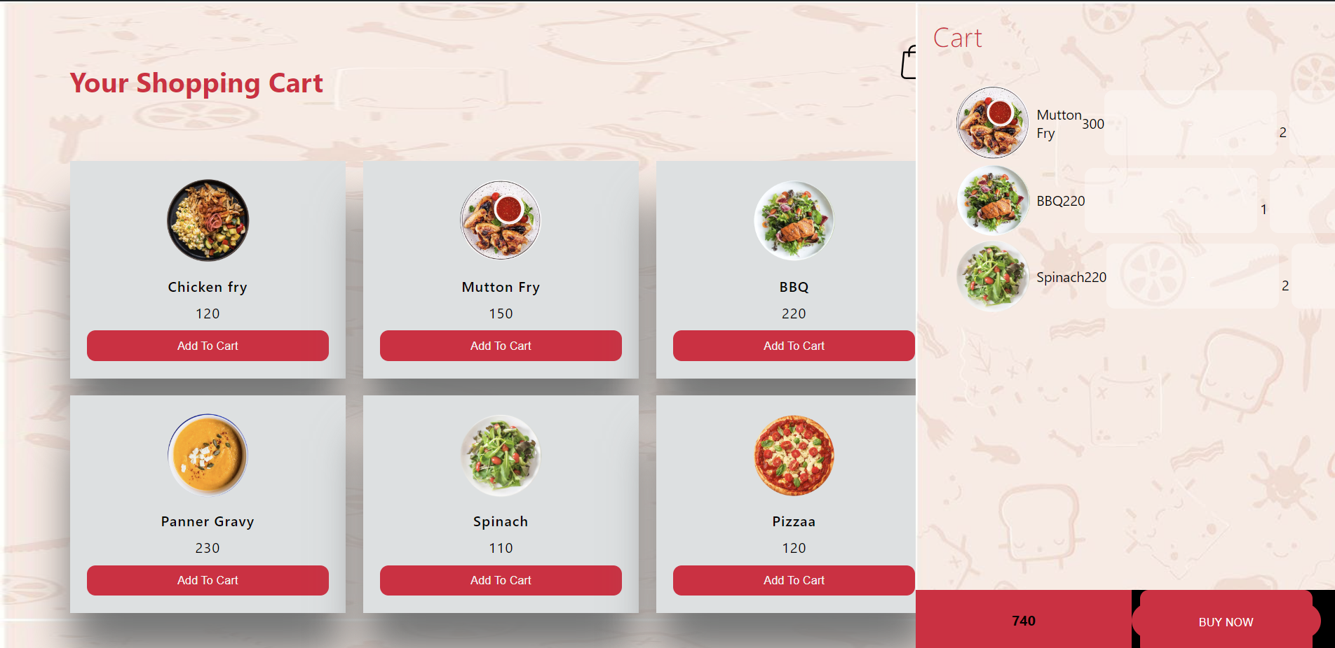
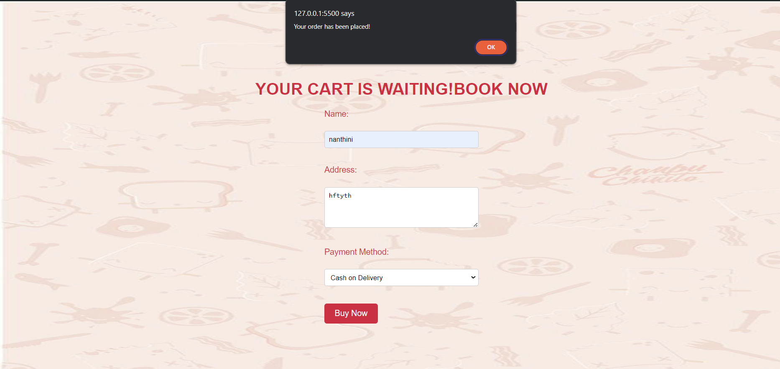
Product Demo

Slide 11
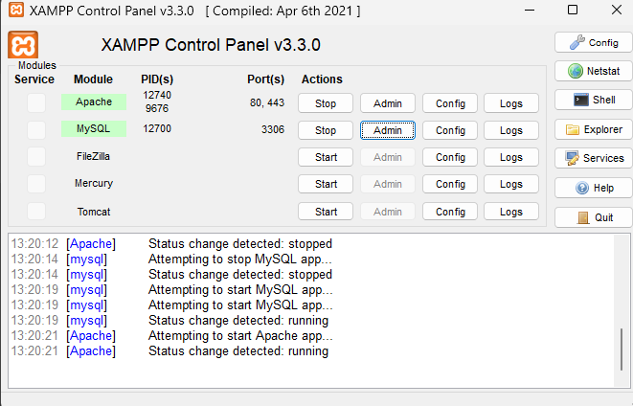
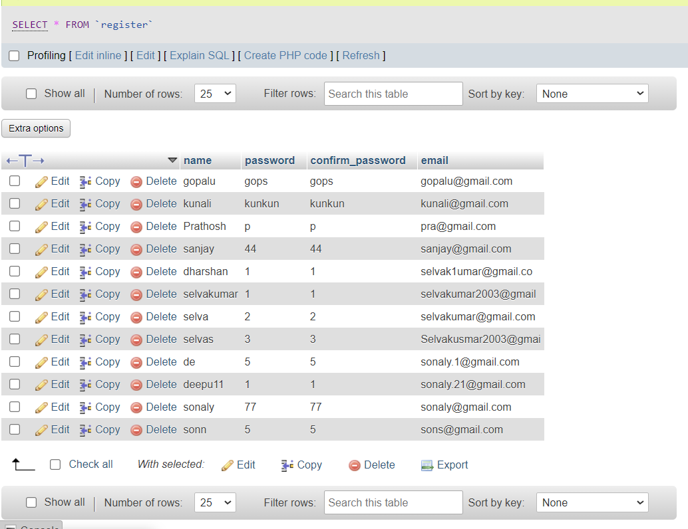
Product Demo(Backend)

Slide 12
ADVANTAGES
Convenience-This app provide convenience by allowing user to order food from their favourite restaurants without leaving home or office.
Time-saving-User can save time by avoiding hassles of cooking.They can simply order food with few taps.
Customization-Allow user to customize their orders such as specifying dietry preferances,extra toppings and modification

Slide 13
THANK
YOU

